Slide 1
Session 03 : Android Environment SDK
Module 4.3 : Android

Slide 2
Learning Objectives
At the end of the session successful participants will be able to
Describe Android Development Tool & Eclipse.
Explain process to create Android project

Slide 3

Android Environment SDK
Android Development Tool & Eclipse
The Android Development Tools (ADT) is a plugin for Eclipse; it adds extensions to the Eclipse IDE.
It allows to create and debug Android applications easier and faster.

Slide 4
Android Environment SDK
Android Development Tool & Eclipse
Advantages
It gives you access to other Android development tools from inside the Eclipse IDE. For example:
Take screenshots
Debug / set breakpoints
View thread and process information directly from Eclipse
It provides a New Project Wizard, which helps you quickly create and set up all of the basic files you'll need for a new Android application.

Slide 5
Android Environment SDK
Android Development Tool & Eclipse
Advantages
It automates and simplifies the process of building your Android application.
It provides an Android code editor that helps you write valid XML for your Android manifest and resource files.
It will export your project into a signed APK, which can be distributed to users.

Slide 6
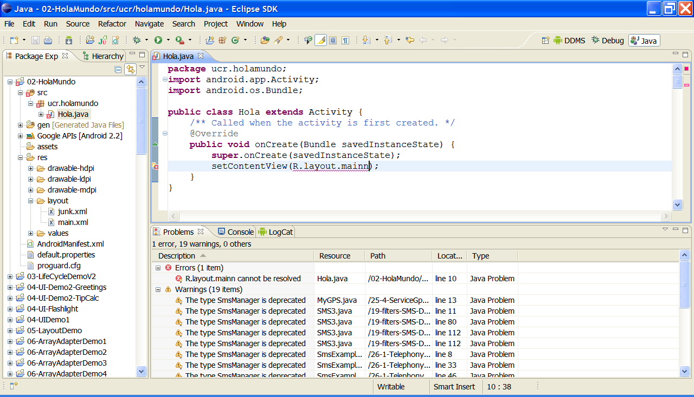
Android Environment SDK
Android Development Tool & Eclipse
Typical Layout of the Eclipse IDE for Android Development:

Slide 7


Android Environment SDK
Android Development Tool & Eclipse
Typical Layout of the Eclipse IDE for Android Development:
Android SDK and AVD Manager
New Android Project
DDMS Perspective
DalvikDebugging Monitoring System

Slide 8
Android Environment SDK
Android Development Tool & Eclipse
Steps you must follow to set up the Android SDK:
Step - 01
Preparing Your Development Computer
Step - 02
Downloading the SDK Starter Package
Step - 03
Installing the ADT Plugin for Eclipse
Step - 04
Adding Platforms and Other Components

Slide 9
Android Environment SDK
Android Development Tool & Eclipse
Step – 01: Preparing Your Development Computer
Make sure you have already installed the most recent JDK.
Make sure you have Eclipse installed on your computer (3.4 or newer is recommended). Eclipse is available from: http://www.eclipse.org/downloads/(For Eclipse 3.5 or newer, the "Eclipse Classic" version is recommended)

Slide 10

Android Environment SDK
Android Development Tool & Eclipse
Step – 02: Downloading the SDK Starter Package
Click the below icon to Download the Android SDK

Slide 11
Android Environment SDK
Android Development Tool & Eclipse
Step – 02: Downloading the SDK Starter Package
If you're already using the Android SDK, you should update to the latest tools or platform using the Android SDK and AVD Manager, rather than downloading a new SDK starter package.
Windows | installer_r08-windows.exe
MAC OS X (intel) | android-sdk_r08-mac_86.zip
Linux (i386) | android-sdk_r08-linux_86.tgz

Slide 12
Android Environment SDK
Android Development Tool & Eclipse
Step – 02: Downloading the SDK Starter Package
The SDK starter package is not a full development environment—it includes only the core SDK Tools, which you can use to download the rest of the SDK components (such as the latest Android platform).
If you downloaded the Windows installer (.exe file), run it now to install the SDK Tools into a default location (which you can modify, usually the folder is:
c:/your-chosen-path/android-sdk-windows

Slide 13
Android Environment SDK
Android Development Tool & Eclipse
Step – 02: Downloading the SDK Starter Package
Make a note of the name and location of the SDK directory on your system—you will need to refer to the SDK directory later, when setting up the ADT plugin and when using the SDK tools from command line.

Slide 14
Android Environment SDK
Android Development Tool & Eclipse
Step – 03: Installing the ADT Plugin for Eclipse
Android offers a custom plugin for the Eclipse IDE, called Android Development Tools (ADT). This is the recommended platform. You may want to first read Installing the ADT Plugin for step-by-step installation instructions, then return here to continue the last step in setting up your Android SDK.

Slide 15
Android Environment SDK
Android Development Tool & Eclipse
Step – 04: Adding Platforms and Other Components
You will use the Android SDK and AVD Manager(a tool included in the SDK starter package) to download essential SDK components into your development environment.
If you used the Windows installer, when you complete the installation wizard, it will launch the Android SDK and AVD Manager with a default set of platforms and other components selected for you to install. Simply click Install to accept the recommended set of components and install them.

Slide 16
Android Environment SDK
Android Development Tool & Eclipse
Step – 04: Adding Platforms and Other Components
You can launch the Android SDK and AVD Manager in one of the following ways:
From within Eclipse, select Window > Android SDK and AVD Manager.
On Windows, double-click the SDK Manager.ext file at the root of the Android SDK directory.
On Mac or Linux, open a terminal and navigate to the tools/directory in the Android SDK, then execute: android

Slide 17
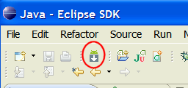
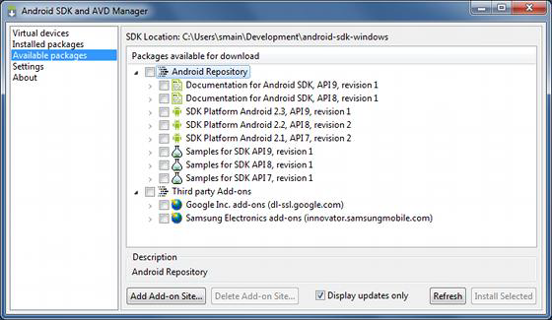
Android Environment SDK
Android Development Tool & Eclipse
Step – 04: Adding Platforms and Other Components
To download components, use the graphical UI of the Android SDK and AVD Manager. To begin with choose only the latest version of Android (include documentation, samples and USB driver) (Warning: this process is slow…)
The Android SDK and AVD Manager's Available Packages panel, which shows the SDK components that are available for you to download into your environment.

Slide 18
Android Environment SDK
Android Development Tool & Eclipse
Installing the Eclipse ADT Plugin
Click the below icon to Download
To simplify ADT setup, it is recommend installing the Android SDK prior to installing ADT.

Slide 19
Android Environment SDK
Android Development Tool & Eclipse
Installing the Eclipse ADT Plugin: Eclipse 3.5 (Galileo) and 3.6 (Helios)
Start Eclipse, then select Help>Install New Software....
Click Add, in the top-right corner.
In the Add Repository dialog that appears, enter "ADT Plugin" for the Name and the following URL for the Location: https://dl-ssl.google.com/android/eclipse/Note: If you have troubles try using "http" instead of "https” Click OK.

Slide 20
Android Environment SDK
Android Development Tool & Eclipse
Installing the Eclipse ADT Plugin: Eclipse 3.5 (Galileo) and 3.6 (Helios)
In the Available Software dialog, select the checkbox next to Developer Tools and click Next.
In the next window, you'll see a list of the tools to be downloaded. Click Next.
Read and accept the license agreements, then click Finish.
When the installation completes, restart Eclipse.

Slide 21
Android Environment SDK
Android Development Tool & Eclipse
Configuring the ADT Plugin: The next step is to modify your ADT preferences in Eclipse to point Android SDK directory:
Select Window>Preferences...to open the Preferences panel (Mac OS X:Eclipse>Preferences).
Select Android from the left panel.
For SDK Location in main panel, click Browse...and locate downloaded SDK directory (c:/path/android-sdk-windows)
Click Apply, then OK.

Slide 22
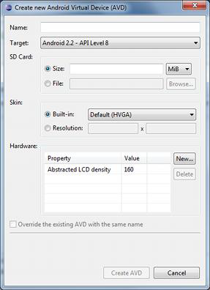
Android Environment SDK
Android Development Tool & Eclipse
Creating an Android Virtual Device (AVD)
Android Virtual Devices (AVDs) are configurations of emulator options that let you better model an actual device.

Slide 23
Android Environment SDK
Android Development Tool & Eclipse
Creating an Android Virtual Device (AVD)
In Eclipse, choose Window>Android SDK & AVD Manager
Select Virtual Devices in the left panel
Click New
The Create New AVD dialog appears

Slide 24
Android Environment SDK
Android Development Tool & Eclipse
Creating an Android Virtual Device (AVD)
Type the name of the AVD, such as “AVD23API9”
Choose a target (such as “Android 2.3 –API Level9”)
Optionally specify any additional settings (SD, camera, trackball, ….) YES to all
Click Create AVD

Slide 25
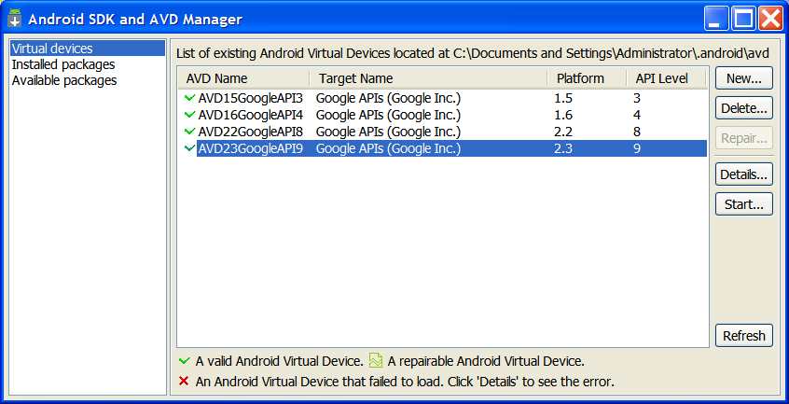
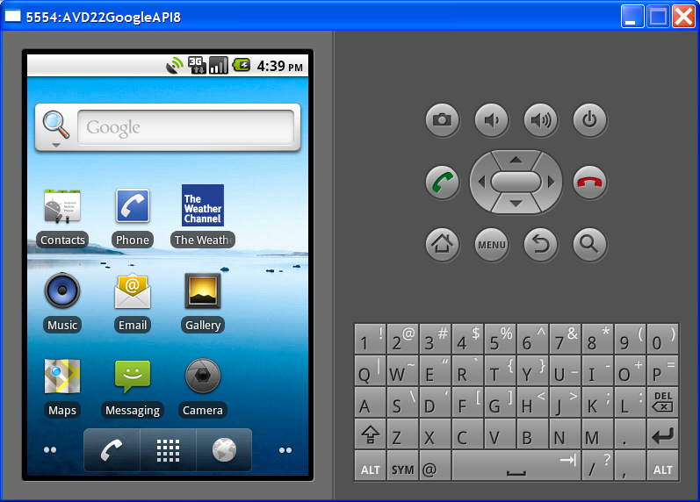
Android Environment SDK
Android Development Tool & Eclipse
Testing The Emulator
Android Virtual Devices (AVDs) are configurations of emulator options that let you better model an actual device.

Slide 26

Android Environment SDK
Android Development Tool & Eclipse
Testing The Emulator
In Eclipse, choose Window > Android SDK and AVD Manager
Select Virtual Devices in the left panel
Click on an AVD
Click Start

Slide 27

Android Environment SDK
Android Development Tool & Eclipse
A Final Step
This seems to be a transitional issue, and may go away in future releases. For now, update the system’s PATH variable to recognize two folders inside your android-sdk-winwows. The first is: tools and the second is platform-tools.

Slide 28
Android Environment SDK
Android Development Tool & Eclipse
A Final Step
Windows > Start > Control Panel > System > Advanced > Environment Variables > System Variables > PATH > Edit
Add references to the sub-folders mentioned above. In this example:
c:\android-sdk-windows\tools; C:\android-sdk-windows\platform-tools;
OK

Slide 29
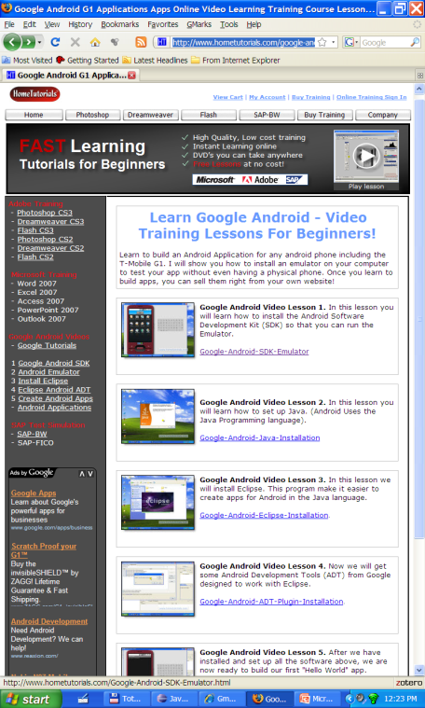
Android Environment SDK
Android Setup Videos
Five videos are available at:
http://www.hometutorials.com/google-android.html
In these videos you will learn about following:
How to setup Java.
How to install Eclipse IDE
Application development: “Hello World” using Eclipse + Android

Slide 30
Android Environment SDK
Android Setup Tutorial
MAC OS Users
In a terminal window send the command: sudosu. You will act as the superuser.
Enter superuser’s password. After accepted, you will issue commands from a shell line.
Locate .profile file and edit (pico, vi,…); path contents at:
exportPATH="/Users/myfolder/android-sdk-mac_86 3/tools“:$PATH
Where "/Users/myfolder/android-sdk-mac_86 3/tools" (including the quotes) is the location of the /tools directory in our Android SDK folder.

Slide 31
Android Environment SDK
Android Setup Tutorial
Install Java
Click the below icon to
Download the latest version of Java SE (JDK)

Slide 32
Android Environment SDK
Android Setup Tutorial
Install Eclipse IDE
Eclipse is a multi-language software development platform comprising an IDE and a plug-in system to extend it. It can be used to develop applications in Java and, by means of the various plug-ins, in other languages

Slide 33
Android Environment SDK
Android Setup Tutorial
Install Eclipse IDE
Click the below icon to
Download the latest version of Eclipse IDE

Slide 34
Android Environment SDK
Android Setup Tutorial
Creating An Android Project
Reference:
http://developer.android.com/guide/developing/eclipse-adt.html

Slide 35
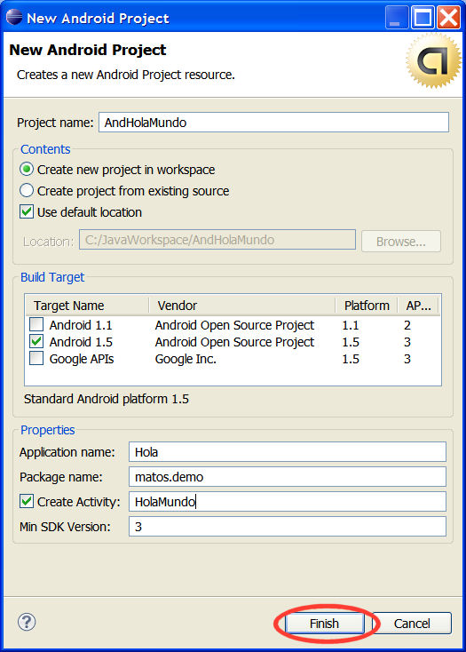
Android Environment SDK
Android Setup Tutorial
Steps to create An Android Project
Start Eclipse
Select File> New> Project
Select Android> Android Project, and click Next
Enter Project name: AndHolaMundo
Select Target Android 1.5

Slide 36
Android Environment SDK
Android Setup Tutorial
Steps to create An Android Project
Application name: Hola
Package name: cis493.demo
Create Activity: HolaMundo
Min SDK Version: 3
Click Finish

Slide 37
Android Environment SDK
Android Setup Tutorial
Creating An Android Project
After creation of New Project, ADT creates the following folders and files in your new project:
src/ Includes your stub Activity Java file. All other Java files for your application go here.
<Android Version>/ (e.g., Android 1.5/) Includes the android .jar file that your application will build against.
gen/ This contains the Java files generated by ADT, such as your R.java file and interfaces created from AIDL files.
assets/ This is empty. You can use it to store raw asset files.

Slide 38
Android Environment SDK
Android Setup Tutorial
Creating An Android Project
After creation of New Project, ADT creates the following folders and files in your new project:
res/A folder for your application resources, such as drawable files, layout files, string values, etc.
AndroidManifest.xml The Android Manifest for your project.
default.properties This file contains project settings, such as the build target.

Slide 39
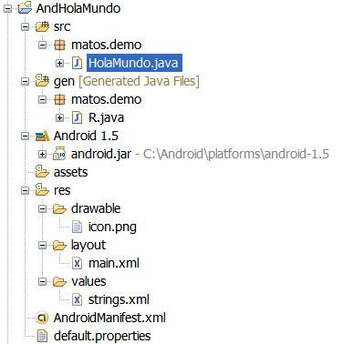
Android Environment SDK
Android Setup Tutorial
Creating An Android Project
After creation of New Project, ADT creates the following folders and files in your new project:

Slide 40
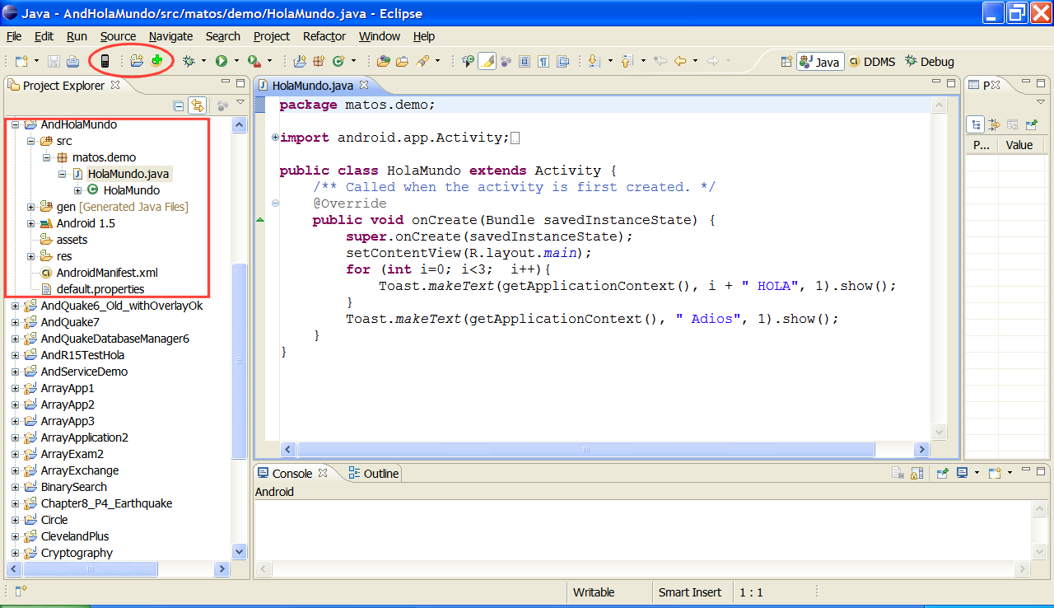
Android Environment SDK
Android Setup Tutorial
Creating An Android Project

Slide 41
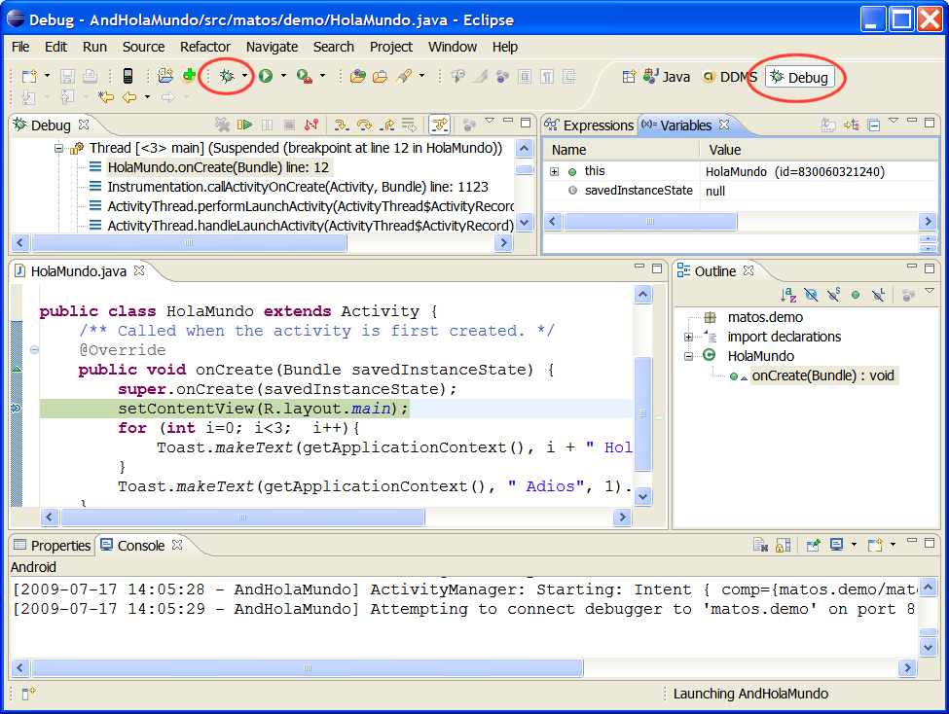
Android Environment SDK
Android Setup Tutorial
Creating An Android Project: Debugging

Slide 42
Android Environment SDK
Android Setup Tutorial
Creating An Android Project: Debugging
package matos.demo;
import android.app.Activity;
import android.os.Bundle;
import android.widget.Toast;
public class HolaMundoextends Activity {
/** Called when the activity is first created. */
@Override
public void onCreate(Bundle savedInstanceState) {
super.onCreate(savedInstanceState);
setContentView(R.layout.main);

Slide 43
Android Environment SDK
Android Setup Tutorial
Creating An Android Project: Debugging
for (int i=0; i<3; i++){
Toast.makeText(getApplicationContext(), i+ " HolaMundo", 1).show();
}
Toast.makeText(getApplicationContext(), " Adios", 1).show();
}
}

Slide 44
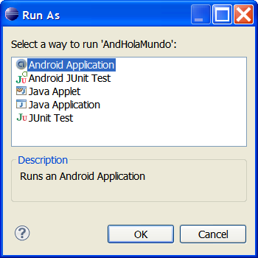
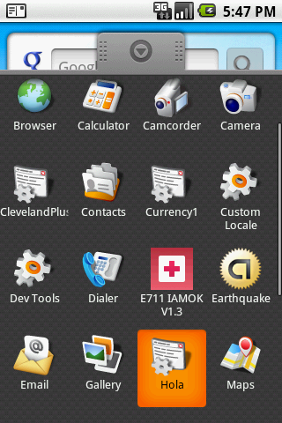
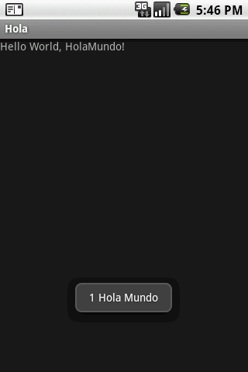
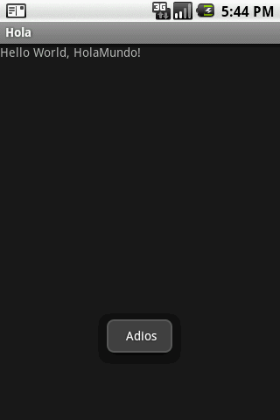
Android Environment SDK
Android Setup Tutorial
Creating An Android Project: Debugging

